Slide 1
Project Dashboard Training Session
Tevis Gehr & Krysten Whearley

Slide 2
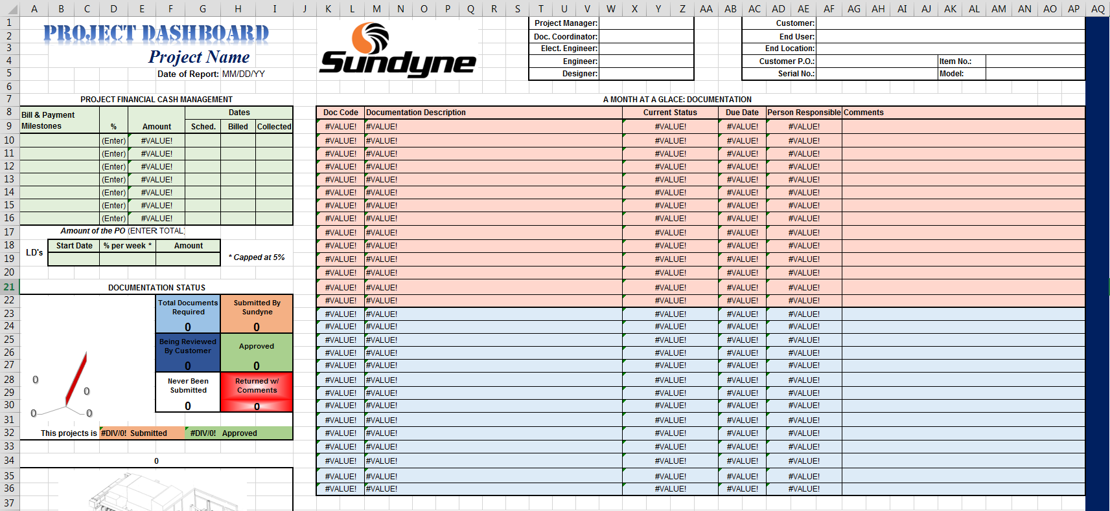
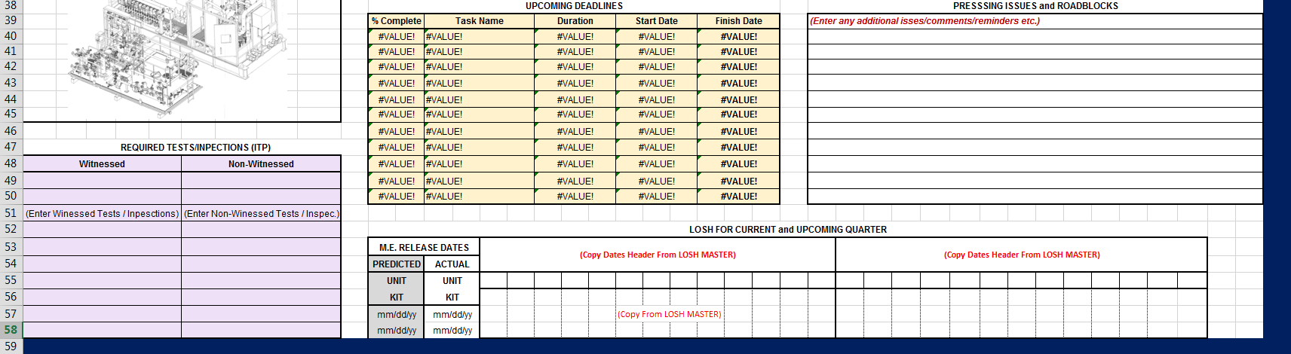
Dashboard Overview
Overall Template

Slide 3
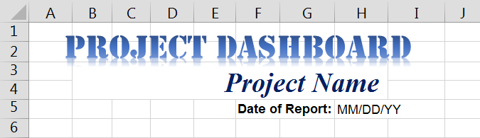
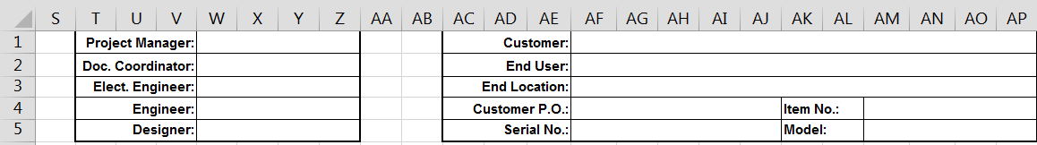
Manually Updated Sections
Header
All must be entered in Manually

Slide 4
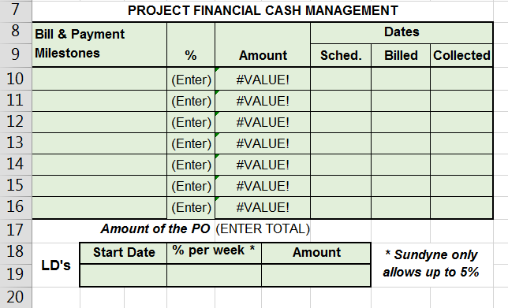
Manually Updated Sections
Project Financial Cash Management
Only “Amount” for each milestone is auto-populated
The rest must be manually input

Slide 5
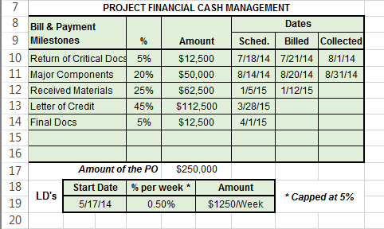
Manually Updated Sections
Project Financial Cash Management
Example of completed section

Slide 6
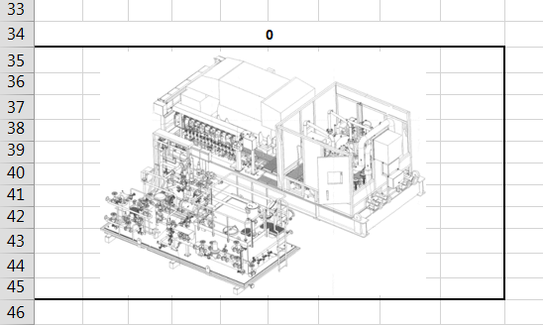
Manually Updated Sections
Model Drawing
Picture file must be obtained from engineering
Then, crop white space out of picture and resize to 2’’ tall to fit in space
Note: “0” will be replaced with the Model # once Header is filled in

Slide 7
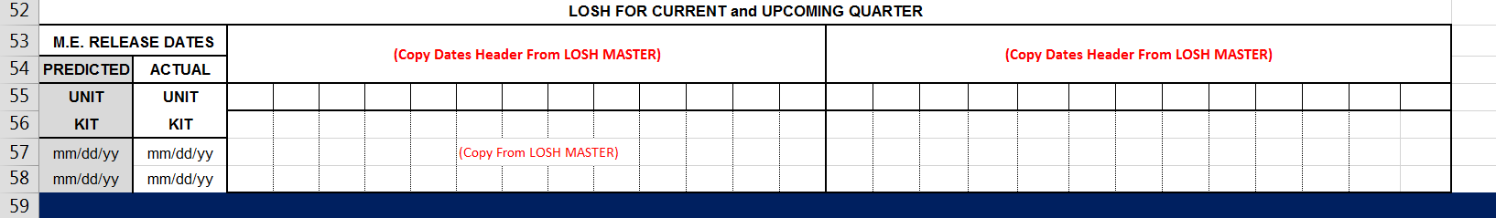
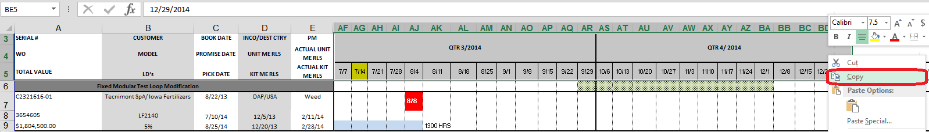
Manually Updated Sections
LOSH for Current and Upcoming Quarter
View when 1st opening Template
Next, go into LOSH document and copy the date headers

Slide 8
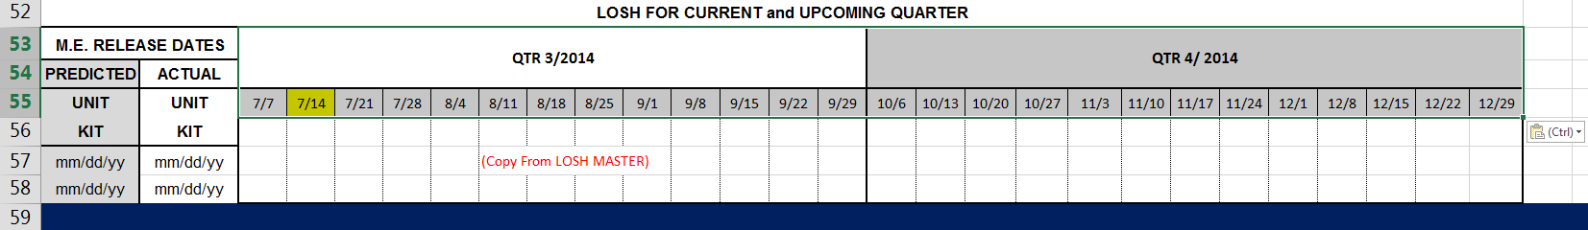
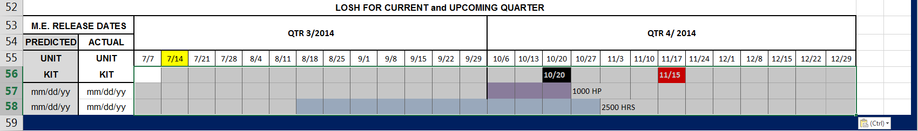
Manually Updated Sections
LOSH for Current and Upcoming Quarter
Paste this info into the LOSH table in Dashboard
Next, go into LOSH document, copy the information for the days selected and paste into LOSH table in Dashboard

Slide 9
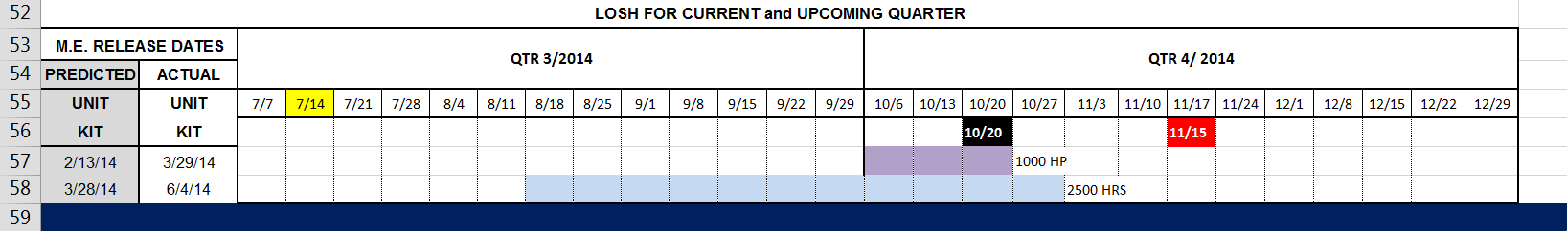
Manually Updated Sections
LOSH for Current and Upcoming Quarter
Lastly, type in the ME Release Dates (from LOSH document)

Slide 10
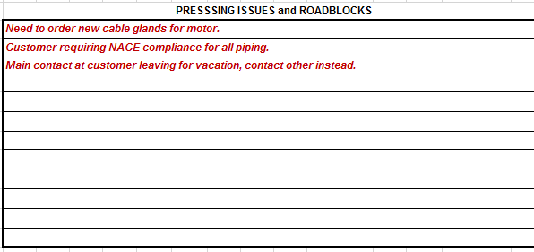
Manually Updated Sections
Pressing Issues and Roadblocks
Enter these in manually
Example:

Slide 11
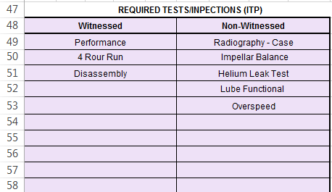
Manually Updated Sections
Required Tests/Inspections (ITP)
The witnessed and non-witnesses tests must be manually entered
Example:

